Slide 1
Building new boxes

Slide 2

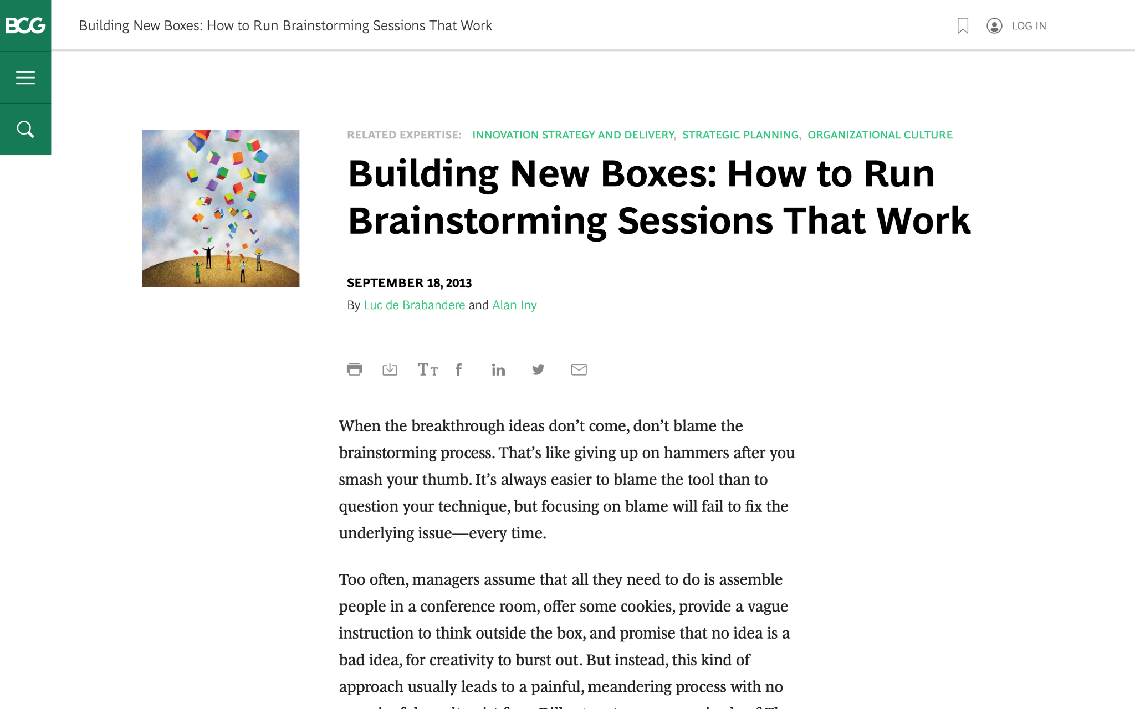
We are going to discuss effective brainstorming. Start by reviewing this article on the BCG website:
Building New Boxes: How to Run Brainstorming Sessions That Work

Slide 3

The article offers five suggestions to achieve real, valuable insights from brainstorming
We will focus on three of these in today’s task (as well as the brainstorming itself), highlighted in green
1.
Frame the question effectively
2.
Create creativity conditions
3.
Reveal and doubt your boxes
4.
Bring new boxes
5.
Follow up
Brainstorm

Slide 4
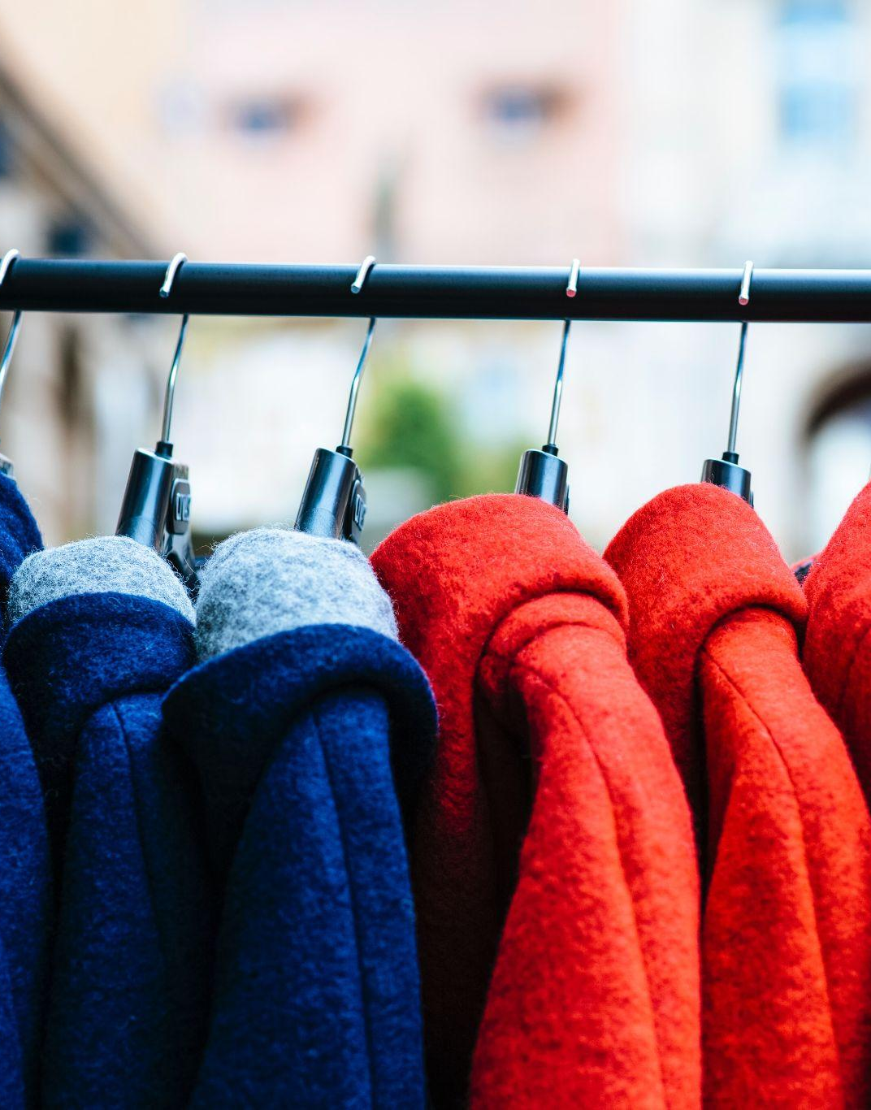
Your task
BCG has been brought in to help ClothingCo, a luxury clothing brand, grow their top line (i.e., increase revenue) after a period of declining sales.
The client is gearing up for the winter season. Imagine that you are a strategy consultant working on the project.
You will enter your responses in the green boxes throughout the remaining slides.

Slide 5
Frame the question effectively
Question to be reframed
How could we sell more outerwear this winter season?
–
Revised, effective questions:
How can we improve the customer experience when purchasing our outerwear?
What would make our winter wear something customers feel compelled to share and talk about ?
How can Clothing Co. leverage technology to enhance the shopping experience and increase sales?
Remember: A good question for brainstorming will be narrow and concrete, so that people feel they know how to begin answering it.
“If I were given one hour to save the planet, I would spend fifty-nine minutes defining the problem and one minute resolving it.”
– Albert Einstein

Slide 6
Reveal and doubt your boxes
In this fictional scenario, make assumptions that seem reasonable
–
What boxes currently exist that are still relevant?
Luxury isn't just about cost; it's about quality, specialness, and unique experiences.
Don't just rely on old ways to reach customers; try digital and influencer marketing.
–
What boxes currently exist that need to be doubted?
Don't assume young people don't like luxury; figure out what kind of luxury appeals to them.
Innovation isn't just about design; think about tech, how customers feel, and new business ideas
The first step in the creative process entails identifying and doubting one’s current boxes and determining which ones require re-evaluation or replacement.
Make a short list of the shared beliefs and assumptions that likely prevail in ClothingCo. Determine which are still relevant and which need to be redefined.

Slide 7
Bring new boxes
New box #1
[Redefining Luxury: From Product to Experience]
Luxury is no longer solely about the product itself, but about the overall experience it provides.
Customers are seeking unique, personalized, and emotionally resonant experiences.
Investing in customer relationships and building brand loyalty through experiences is crucial.
New box #2
[Eco-Luxury: A Sustainable Future]
Clothing Co. can leverage sustainable practices to enhance its brand image and attract environmentally conscious customers.
Circular economy principles (reduce, reuse, recycle) can be applied to the fashion industry.
Transparency and traceability of materials and manufacturing processes are essential for building trust with consumers.
Prepare for brainstorming by creating new boxes to bring to the session; new boxes will nurture ideation and can dramatically increase the odds of a useful result.
Remember: Defining new boxes requires a mixture of analysis and art. Boxes need to be grounded in fact. Different sectors will call for different inputs.

Slide 8
Brainstorm
Choose one of the effective questions you created on slide 5, and a new box from slide 7, and brainstorm potential ideas to address the questions
Question | How can Clothing Co. leverage technology to enhance the shopping experience and increase sales?
New box | Eco-Personalized Luxury
Create an AI-powered personal shopper to offer tailored recommendations based on customer data.
Seamlessly integrate online and offline channels to provide a consistent and convenient shopping experience.
Partner with suppliers who prioritize sustainable and ethical sourcing practices.
Host virtual fashion shows and immersive experiences in the metaverse, allowing customers to interact with the brand and its products in a unique and engaging way.
Implement a take-back program to recycle and repurpose old clothing.
Offer rental services for special occasion wear.

